Slide 1
Implement Bubble Sort Using 8085 Assembly Language

Slide 2
Welcome To Our Presentation.
Mijanur Rahaman Joy
Id: 2017-2-60-070
Swakshar Debnath
Id: 2017-2-60-034
Efat Ara Minu
Id: 2017-1-60-059

Slide 3
What Is Bubble Sort
ABSTRACT
Sorting algorithms provide a way to arrange a series of numbers or letters in some predefined order based on some measurable quantity in the numbers or letters.
Thus we may arrange a series of numbers according to their values in an increasing order or we may arrange the letters according to decreasing order of their values using sorting.
In this project we will describe a simple and easy to implement sorting algorithm called Bubble Sort.

Slide 4
INTRODUCTION
Given a list of n numbers or letters the objective of any sorting algorithm is to arrange the same in a particular order where the ordering is done based on some intrinsic property of the inputs. The simplest way to sort a list of input values is to compare them pairwise and obtain the proper ordering. Sorting algorithms that achieve their goal by comparison are called comparison based sorting algorithm.
Bubble Sort is a simple and easy to implement comparison based sorting algorithm. We will describe the algorithm by sorting a list of n numbers in increasing order of magnitude. The same process can be followed to sort a list of letters according to some criteria. The input to the algorithm will be a list of n numbers in a random order and the output will be a list of the same n numbers arranged in an increasing order of magnitude.

Slide 5
8085 Microprocessor.
8085 is pronounced as "eighty-eighty-five" microprocessor. It is an 8-bit microprocessor designed by Intel in 1977 using NMOS technology.
It has 8-bit data bus and 16-bit address bus, which can address upto 64KB. And a 16-bit program counter and a 16-bit stack pointer.

Slide 6
8085 consists of the following functional units −
Accumulator
Arithmetic and logic unit
General purpose register
Program counter
Stack pointer
Temporary register
Flag register
Interrupt control
Address buffer and address-data buffer
Address bus and data bus

Slide 7
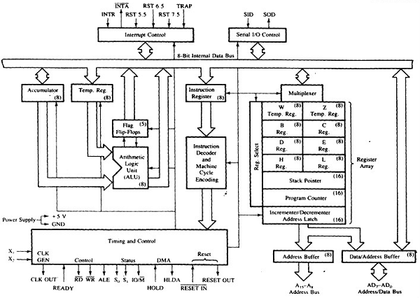
8085 Architecture

Slide 8
Bubble Sort Program Using 8085 Assembly Language

Slide 9
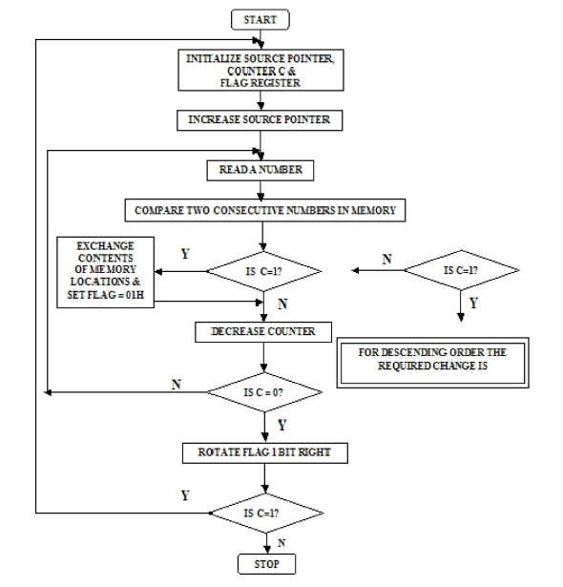
Flow Diagram

Slide 10
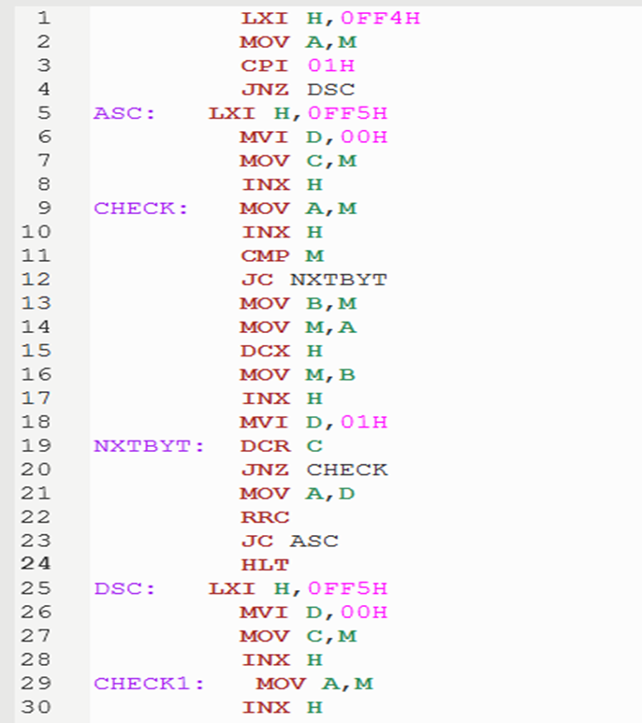
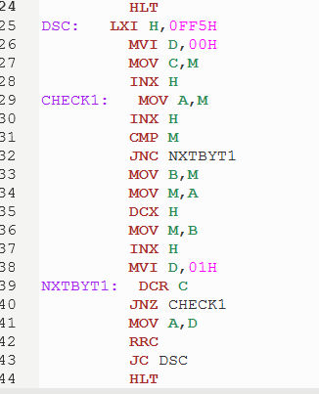

Slide 11
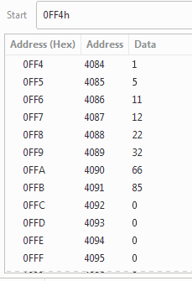
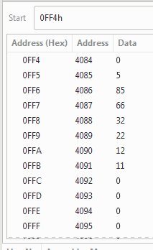
OUTPUT
Ascending Order
Descending Order

Slide 12
THANK YOU!

